Slide 1
Constructing Inverse Probability Weights for Dynamic Interventions
When to Monitor CD4 and RNA
CIMPOD 2017
Lauren Cain
Principal Statistician, Takeda Pharmaceuticals
Visiting Scientist, Harvard T.H. Chan School of Public Health

Slide 2
Acknowlegement
Ellen Caniglia was the first author of this work
  Completed the analyses
  Drafted the paper
Met with me to share her SAS code and help design the lab exercise

Slide 3
Outline for today
Introduction to the Case-Study
Guided Exercises with Example Data
(Using SAS)
Q&A

Slide 4
1. Introduction to the
Case-Study

Slide 5
Motivating question
What is the optimal frequency with which to monitor CD4 cell count and HIV RNA?
Can the monitoring frequency be decreased for healthy individuals on treatment?

Slide 6
Clinical guidelines:
Examples of dynamic strategies
Guidelines | Monitor CD4 | Monitor HIV RNA
European AIDS Clinical Society | Every 3-6 months Annually if CD4 >350 and undetectable viral load | Frequently immediately following initiation Every 3-6 months thereafter
Department of Health and Human Services | Every 3-6 months Annually if undetectable viral load and CD4>300 for 2 years Optional if undetectable viral load and CD4>500 for 2 years | 2-8 weeks after initiation Every 4-8 weeks thereafter Every 3-4 months once viral load undetectable Every 6 months once suppressed for >2 years

Slide 7
Strategy Classifications
Static (non-dynamic) strategies:
  do not depend on time dependent covariates
Dynamic strategies:
  depend on time dependent covariates

Slide 8
Examples of strategies:
Initiate cART…
Static strategies
  …at first visit
  …after 3 months
Rarely used in clinical practice
Most RCTs
Non optimal strategies
Dynamic strategies
  …when CD4<500
  …when CD4<200
Most common in clinical practice
Rarely RCTs
Optimal strategy
is dynamic

Slide 9
Examples of strategies:
Initiate cART…
…after 3 months
Strategy assigned at baseline
…when CD4<500
Strategy assigned at baseline
id | month | CD4 | cART
1 | 0
1 | 1
1 | 2
1 | 3
1 | 4
1 | 5
1 | 6
id | month | CD4 | cART
1 | 0
1 | 1
1 | 2
1 | 3
1 | 4
1 | 5
1 | 6

Slide 10
Examples of strategies:
Initiate cART…
…after 3 months
Strategy assigned at baseline
Treatment given known at baseline
…when CD4<500
Strategy assigned at baseline
Treatment given not known at baseline
id | month | CD4 | cART
1 | 0 | ? | 0
1 | 1 | ? | 0
1 | 2 | ? | 0
1 | 3 | ? | 1
1 | 4 | ? | 1
1 | 5 | ? | 1
1 | 6 | ? | 1
id | month | CD4 | cART
1 | 0 | ? | ?
1 | 1 | ? | ?
1 | 2 | ? | ?
1 | 3 | ? | ?
1 | 4 | ? | ?
1 | 5 | ? | ?
1 | 6 | ? | ?

Slide 11
Examples of strategies:
Initiate cART…
…after 3 months
Strategy assigned at baseline
Treatment given known at baseline
Treatment does not depend
on time-varying CD4
…when CD4<500
Strategy assigned at baseline
Treatment given not known at baseline
Treatment depends on time-varying CD4
id | month | CD4 | cART
1 | 0 | 600 | 0
1 | 1 | 580 | 0
1 | 2 | 560 | 0
1 | 3 | 540 | 1
1 | 4 | 520 | 1
1 | 5 | 500 | 1
1 | 6 | 480 | 1
id | month | CD4 | cART
1 | 0 | 600 | 0
1 | 1 | 580 | 0
1 | 2 | 560 | 0
1 | 3 | 540 | 0
1 | 4 | 520 | 0
1 | 5 | 500 | 0
1 | 6 | 480 | 1

Slide 12
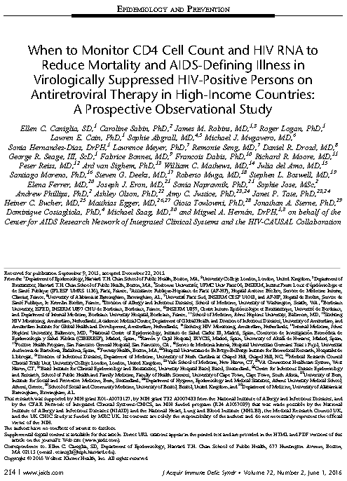
Clinical Paper
  The HIV-CAUSAL Collaboration
  CNICS
  Used IP weighting methods to compare dynamic monitoring strategies

Slide 13
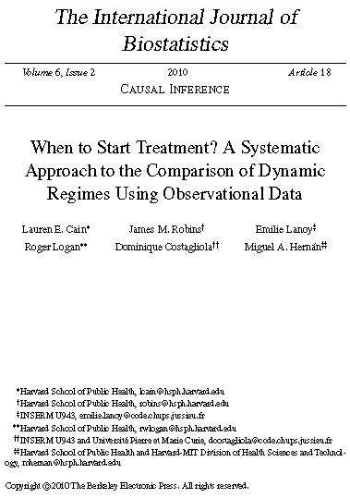
Methods Paper
  Subset of HIV-CAUSAL Collaboration
  How to use IPW to compare dynamic strategies with grace periods

Slide 14
The HIV-CAUSAL Collaboration:
Contributing cohorts
France: FHDH, PRIMO, SEROCO
Spain: PISCIS, CoRIS, CoRIS MD, GEMES
UK: UK CHIC, UK Register of Seroconverters
Netherlands: ATHENA
Switzerland: SHCS
United States: VACS-VC
Greece: AMACS
Canada: South Alberta HIV Cohort
Brazil: IPEC

Slide 15
The CNICS:
Contributing cohorts
Case Western Reserve University
Fenway Community Health Clinic
Johns Hopkins University
University of Alabama at Birmingham
University of California at San Diego
University of California at San Francisco
University of North Carolina
University of Washington

Slide 16
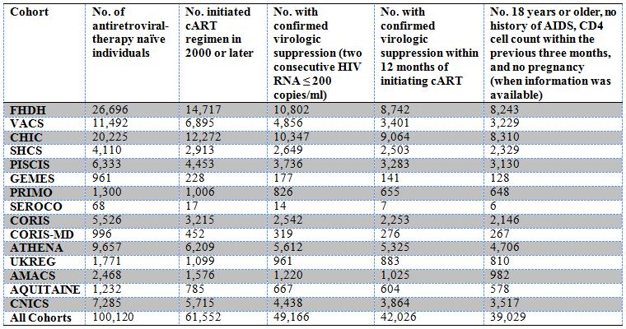
Sample Size

Slide 17
Baseline covariates
Cohort
Sex
Age
Race (white, black, other or unknown)
Geographic origin (Western developed countries, other or unknown)
Acquisition group (heterosexual, homosexual/bisexual, injection drug use, other or unknown)
CD4 cell count
HIV-1 RNA
Calendar year
Years since HIV diagnosis
Months to suppression

Slide 18
Time-varying covariates
CD4 cell count
HIV-1 RNA
Time since last laboratory measurement
AIDS-defining illness (when outcome is death)

Slide 19
3 monitoring strategies
Monitor CD4 cell count and HIV-RNA once every…
  3 ± 1 months
  6 ± 1 months or 3 ± 1 months
  if HIV-RNA > 200 or CD4 ≤ 200
  9-12 ± 1 months or 3 ± 1 months
  if HIV-RNA > 200 or CD4 ≤ 200
Optimal strategy
= highest AIDS-free survival

Slide 20
Preferred method:
Randomized clinical trial (RCT)
Identify eligible individuals
  HIV-positive, AIDS-free
  Virologically suppressed within 12 months of cART initiation
Randomly assign each eligible individual to one of the 3 strategies
Follow until AIDS, death or administrative end of follow-up

Slide 21
Alternative method:
Emulate a RCT
Use observational data
Identify eligible individuals & observations
  Baseline = Date of confirmed virologic suppression following cART initiation (within 12 months)
  HIV-positive, AIDS-free, CD4 measurement at baseline
Determine which of the 3 strategies they are following
  “Assign” them to follow those strategies
  Artificially censor them if and when they deviate
Follow until AIDS, death, censoring, or administrative end of follow-up

Slide 22
Need for causal inference methods
Traditional methods cannot appropriately adjust for time-varying confounders affected by prior exposure
  CD4/RNA affect decision to monitor
  Monitoring may affect future values of CD4/RNA
The comparison of dynamic strategies requires novel statistical methods designed specifically for dynamic strategies and time-varying confounding

Slide 23
2. Guided Exercises with Example Data (Using SAS)

Slide 24
Example Data
Simulated data set based on the
HIV-CAUSAL Collaboration
Using a random sample of eligible individuals from that data set

Slide 25
Simulated v. real data
No losses to follow up
One lab measurement per month
Temporal order of variables within month known
  Lab measurements
  Treatment
  Censoring
  Outcome

Slide 26
Pre-Processing of Data
Identify eligible individuals & observations
  Found baseline and set it to month = 0
  Removed ineligible individuals and observations
AIDS or death as the event

Slide 27
Getting Started
Open the program:
analysis_wtm.sas
Read in the data set: wtm_aidsdeath.sas7bdat
Look carefully at the data

Slide 28
Step 0:
Create a time-varying monitoring variable for use in the weight models
Categorize several continuous variables

Slide 29
Step 1:
Fit a model for monitoring using proc logistic
Merge the output of the proc logistic with the original data set

Slide 30
Step 2:
Create 3 replicates of each individual

Slide 31
Step 2:
Why are we creating replicates?
All individuals have data that are consistent with all 3 strategies at baseline
Randomly allocate an individual to one of the strategies he follows
“Assign” individuals to follow more than one strategy

Slide 32
Step 3:
Censor replicates when they deviate from their assigned strategy
Identify the beginning of each monitoring grace period
Count the replicates and events for each strategy

Slide 33
Step 3:
Reasons for censoring:
  Monitored too soon
  Not monitored soon enough
  CD4 or RNA monitored, but not both
Note: Censoring is a function of…
  Monitoring
  A subset of the prognostic factors
  (i.e., CD4 and RNA)

Slide 34
Step 3:
Example
An individual is monitored every 6 months
  She has data consistent with all 3 strategies at baseline ⇨ 3 copies (1 per strategy)
  Censor the copies if she is:
    Monitored “too soon”
    Not monitored “soon enough”

Slide 35
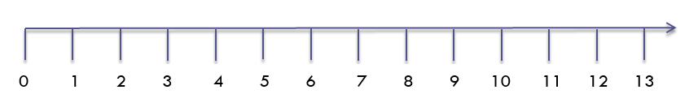
Step 3:
Example of censoring process
•
•
•
Copy 1
3 months
month
•
•
•
Copy 2
6 months
month
•
•
•
Copy 3
9-12 months
month
• monitor
censor

Slide 36
Step 4:
Build the unstabilized IP weights
Truncate the weights

Slide 37
Step 4: Why are we building IP weights?
Censoring may introduce time-dependent selection bias
Weight by the inverse probability of remaining uncensored

Slide 38
Step 4: Weights for monitoring or for censoring?
Recall: Censoring is a function of…
  Monitoring
  CD4/RNA
Conditional probability of remaining uncensored
  = Conditional probability of not monitoring
  (before the grace period)
  = Conditional probability of monitoring CD4 or RNA but not both (during the grace period)
  = Conditional probability of monitoring
  (end of the grace period)

Slide 39
Step 4: Adjusting for time-varying selection bias
Use IP weighting to create a pseudo-population in which monitoring is independent of measured past prognostic factors
In the pseudo-population, the artificial censoring is noninformative
  Under the assumptions of conditional exchangeability, positivity, and consistency

Slide 40
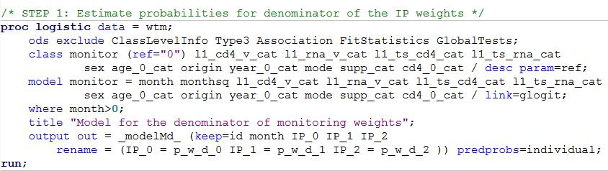
Step 4:
IP Weights

Slide 41
Step 4:
Contributions to the weights
Time Point |  | Contribution
Before gp | j < 0 | 1/p_w_d_0
During gp | 0 ≤ j < m | 1 – (1/p_w_d_1)
End of gp | j = m | 1/p_w_d_2

Slide 42
Step 4: Stabilized weights?
Issues with unstabilized weights
  High weight to subjects with low probability of receiving the exposure level that they indeed received
  Estimators with large variance
Stabilized weights preferred
(for static strategies)
  Estimators with smaller variance
  Easier to evaluate model specification

Slide 43
Step 4: Stabilized weights?
Common stabilization procedures for static strategies are not valid for dynamic strategies
Numerator can depend on regime and time-varying covariates, but not past monitoring
In practice, simple stabilization does not actually stabilize
Optimal, locally semiparametric efficient weights derived by Orellana et al., 2010ab

Slide 44
Step 4: Truncated weights?
Reset the value of the highest
(and lowest) weights
Reduce influence of observations with extreme weights
Increases bias and precision

Slide 45
Step 5:
Fit an inverse-probability weighted dynamic marginal structural model to estimate the hazard ratios

Slide 46
Step 5: Proc Surveylogistic
Replicates are correlated
Must adjust variance estimation to account for replicates
Robust variance (cluster statement)
Bootstrap entire process

Slide 47
Step 6:
Fit a pooled logistic model with interactions between regime and time
Estimate the 18-month AIDS-free survival
Plot the AIDS-free survival curves

Slide 48
Step 6:
The procedure
Fit a model like the one in Step 5, but with interactions between regime and time
Create a skeleton data set with all possible time points for each individual under each treatment strategy
Score the skeleton data set using the output of the pooled logistic model to get predicted probabilities of the event
Calculate and graph the AIDS-free survival at each time for each strategy

Slide 49
Causal Interpretation
Hazard ratios (or survival) that would have been estimated had all individuals been monitored according to the study protocol

Slide 50
Assumptions
No unmeasured confounding given the measured covariates
Correct specification of the model for monitoring as a function of the measured confounders
Positivity (i.e., no deterministic “assignment” of the monitoring strategies)

Slide 51
Next steps
More complex strategies when outcome is death
Monitor CD4 cell count and HIV-RNA once every…
  3 ± 1 months
  6 ± 1 months or 3 ± 1 months
  if HIV-RNA > 200, CD4 ≤ 200, or AIDS
  9-12 ± 1 months or 3 ± 1 months
  if HIV-RNA > 200, CD4 ≤ 200, or AIDS

Slide 52
Next steps
Sensitivity Analyses
  Inverse probability weights to adjust for loss to follow-up
  Subset analyses

Slide 53


Next steps
Alternative, possibly more clinically relevant strategies
  Uniform monitoring during the grace period
  Add a numerator
    If 0 ≤ j < m and ART = 1
    If 0 ≤ j < m and ART = 0
    If j =m

Slide 54
The framework
Learned an approach to answer a clinical question in which a target trial is described in detail and emulated
Can be applied to a wide variety of questions, data sources, and methods

Slide 55
Advantages of framework
Well-defined strategies and effect estimates
Avoids common biases
Allows systematic evaluation
Helps explain differences between studies

Slide 56
Closing messages
Save computing time by fitting weight model before making replicates
Pay careful attention to the reasons for censoring and assign contributions to the weights accordingly
Don’t automatically stabilize weights

Slide 57
Acknowledgements
Co-investigators
  At HSPH: Ellen Caniglia, Miguel Hernán, Jamie Robins, Roger Logan
  Members of the HIV-CAUSAL Collaboration
Funding Sources
  NIH grants: R01-AI073127 and U10-AA013566

Slide 58
Additional References
Multiple regimes
  Robins et al. Statistics in Medicine 2008
IP weighting for dynamic regimes
  Hernán et al. BCP&T 2006
  Robins et al. Statistics in Medicine 2008
Smoothing
  Robins et al. Statistics in Medicine 2008
Grace periods
  Cain et al. International Journal of Biostatistics 2010
Dynamic MSMs reviewed in
  Robins and Hernán. In: Advances in Longitudinal Data Analysis. Chapman and Hall/CRC Press, 2009

Slide 59
My Contact Information
Takeda Pharmaceuticals
lauren.cain@takeda.com
Harvard T.H. Chan School
of Public Health
lcain@hsph.harvard.edu

Slide 60
Constructing Inverse Probability Weights for Dynamic Interventions
When to Monitor CD4 and RNA
CIMPOD 2017
Lauren Cain
Principal Statistician, Takeda Pharmaceuticals
Visiting Scientist, Harvard T.H. Chan School of Public Health

Slide 61
3. Results from the
Case-Study

Slide 62
All-cause mortality
Monitoring strategy | Outcomes, cases | Person-months | Hazard ratios* (95% CI)
Once every 3±1 months | 126 | 345,310 | 1.00 (reference)
Once every 6±1 months | 72 | 208,055 | 0.86 (0.42, 1.78)
Once every 9-12±1 months | 67 | 189,900 | 0.82 (0.46, 1.47)
*Adjusted for the baseline and time-varying covariates
Notes:
Little evidence for an effect of monitoring frequency on death

Slide 63
AIDS-defining illness or death
Monitoring strategy | Outcomes, cases | Person-months | Hazard ratios* (95% CI)
Once every 3±1 months | 310 | 344,246 | 1.00 (reference)
Once every 6±1 months | 197 | 207,446 | 0.76 (0.50, 1.16)
Once every 9-12±1 months | 183 | 189,353 | 1.06 (0.55, 2.08)
*Adjusted for the baseline and time-varying covariates
Notes:
Little evidence for an effect of monitoring frequency on aids/death

Slide 64
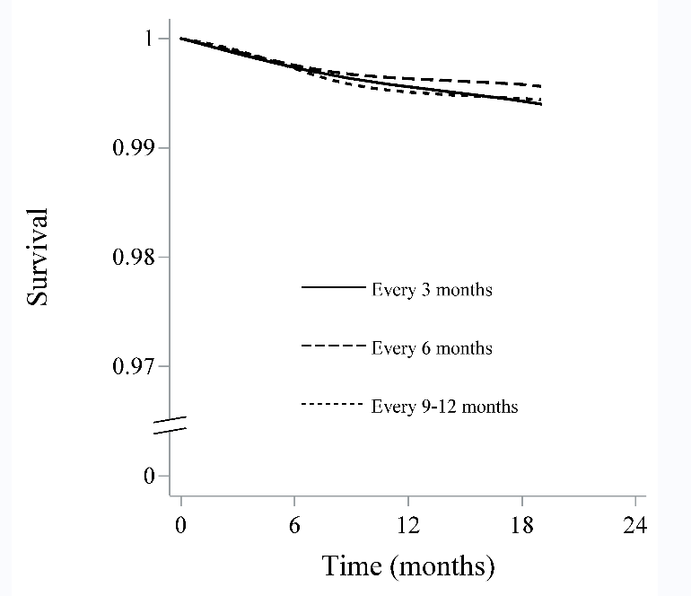
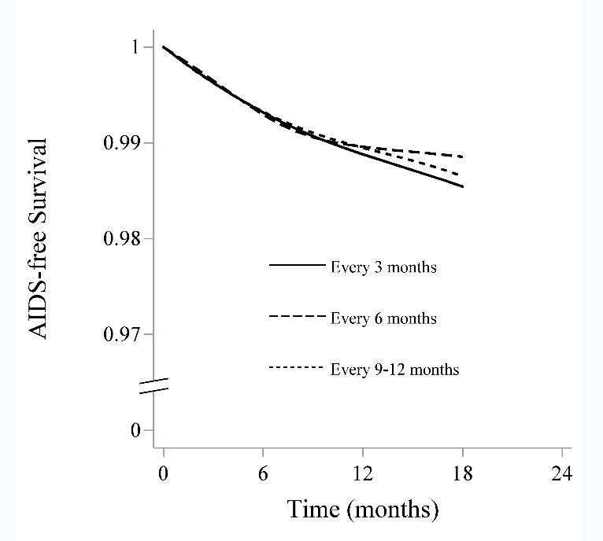
Survival and AIDS-free survival
Notes:
18-month survival: 0.994; 0.996; 0.995
18-month AIDS-free surivval: 0.985, 0.989, 0.987

